Slide 1


School of Computer Science & IT Department of BCA
INTRODUCTION TO LINUX(20BCA1C06)
MODULE 3: Vi Editor
Faculty : Dr. Ananta Ojha

Slide 2
Session-3
Programming with the Shell
Basics
Types of Shell
Executing Shell Script

Slide 3
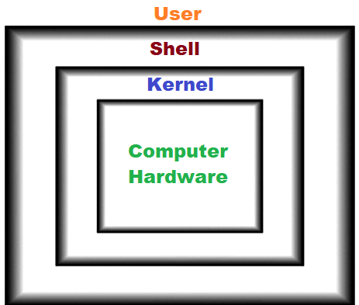
Basics
Shell is the command interpreter; it interprets user commands and interacts with the Kernel to perform the tasks on behalf of the user in the Unix/Linux environment.
It also offers programming capability using which a user can control how and when commands are to be executed.
Programs written in shell command language are called shell scripts. At its simplest form a shell script is just a sequence of commands that have been saved in a file.
Why Shell Scripts?
The shell is a high-level programming language and easier to learn than other languages such as C or C++.
Shell scripts are generally faster to write and often easier to debug than corresponding C programs.
Shell scripts are interpreted rather than compiled; No need to convert it to binary executables.
If you are writing a program that relies heavily on UNIX commands, shell script is an excellent choice.
For quickly writing relatively short programs, shell script is a much better choice, but for large and complex systems programming tasks, C is clearly superior.

Slide 4
Some use cases for Shell Script
How to use
Combine lengthy and repetitive sequences of commands into a single, simple command using shell script to work with file system.
Generalize a sequence of operations on one set of data, into a script that can be applied to any similar set of data in text processing.
Create new commands using combinations of utilities in ways the original authors never thought of.
When to use
System boot scripts to customize Unix/Linux environment
System administrators, for automating many aspects of computer maintenance, user account creation, backup procedure etc.
Application package installation tools for initialization setup
Application startup scripts, to perform some repeated configuration tasks

Slide 5
Types of Shells
The original UNIX System shell, sh, was written by Steve Bourne in 1978, and it is known after his name. Because it was the first, the Bourne shell lacks many enhancements common to the later shells. It can still be useful for certain tasks such as scripting, but almost all users will prefer one of the newer shells for entering commands. ( part of AT&T version of Unix)
The C shell, csh, was the first attempt to enhance the original Bourne shell. The syntax was strongly influenced by the C programming language. The C shell introduced the concepts of a command history list, job control, and aliases. However, like sh, it lacks some important features of later shells. A common complaint about csh is that the new syntax is not compatible with the Bourne shell, and so some scripts may not work properly in csh. ( part of BSD version of Unix)
The extended C shell, tcsh, has replaced csh entirely on some versions of UNIX (including Linux). It retains all the features of csh and adds command-line editing (a very important shell feature) and history completion. It is one of the more popular shells, although like csh it has been criticized for not being compatible with the Bourne shell.
The Korn shell, ksh, was developed at AT&T Bell Laboratories by David Korn. Unlike the C shell, the Korn shell has a syntax compatible with sh. Like tcsh, ksh includes a command history list, job control, aliases, and command-line editing.
The Bourne Again Shell, bash, is part of the GNU project. It extends ksh further, while remaining compatible with the original Bourne shell syntax, and adds a few features from tcsh as well. bash is the default shell in Linux and may be the most popular shell today. On some systems, the command sh will run bash instead.

Slide 6
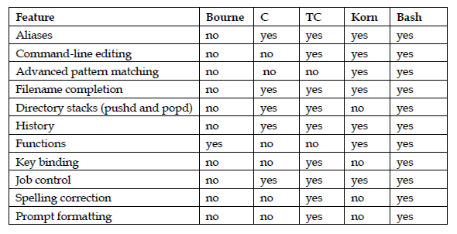
Comparison:
sh-Bourne Shell; csh-C Shell; ksh-Korn Shell; tcsh-Extended C Shell; bash-Bourne Again Shell

Slide 7
Your First Encounter with a Script
Creating a Script File
Using any text editor of your choice such as vi or gedit, create a new file hello.sh with the following:
#!/bin/bash
# This is my First Script
echo "Hello World"
ls
date
Executing a Script File
Use any of the following ways to execute the script file hello.sh ( invoking shell type or using dot command)
$ bash hello.sh
$ sh hello.sh
$ . hello.sh
Use chmod command to make the script file hello.sh executable
$ chmod +x hello.sh
Now you can execute the file like a command by typing the name of the executable file and prefixing it with a dot and slash combination if the script is in your current directory. Here dot refers to current directory and slash is pathname separator. If it is in a different directory, then use appropriate pathname with the executable script file name.
$ ./hello.sh

Slide 8
Understanding the First Script
The #!/bin/bash line is called the shebang line. The #! Character sequence is, in fact, a special construct called a shebang. The shebang is used to tell the system the name of the interpreter that should be used to execute the script that follows. This should always be the first line in a Shell script.
If the shell that executes your script is available by prior configurations then the shebang line can be omitted.
The next few lines in the shell script are self explanatory:
Any line starting with #, will be treated as a comment line. An exception to this would be the first line with #!/bin/bash
The echo command will print HelloWorld on the screen
The ls command will display directory content on the console
The date command will show the current date and time
File name extension .sh is not mandatory

Slide 9
Configuring vi For Script Writing
Install the advanced version of vi to support syntax highlighting
$ sudo apt install vim
When your script file is open in vi/vim editor use the following configuration settings for ease script development:
Turn on syntax highlighting.
:syntax on
Turn on the option to highlight search results.
:set hlsearch
Turn on the “auto indent” feature.
:set autoindent
Turn on line numbering.
:set number
sets the number of columns occupied by a tab character.
:set tabstop=4

Slide 10
Another Simple Script
#This is another simple script, no shebang
echo “Hello `logname`, have a nice day!”
echo “Your machine name is: `uname -n`”
echo “Your current working directory is: `pwd`”
echo “Here is the listing:”
ls -x
echo “Bye!”
Explanation:
`logname` is a command that displays login name
`uname -n` is a command displays system information; -n option displays hostname
You need to keep in mind the difference between single quotes and back quotes. Single quotes treat a Linux command as a set of characters. Back quotes force execution of the Linux command.

Slide 11

THANK YOU Any questions…?

